Slide 1
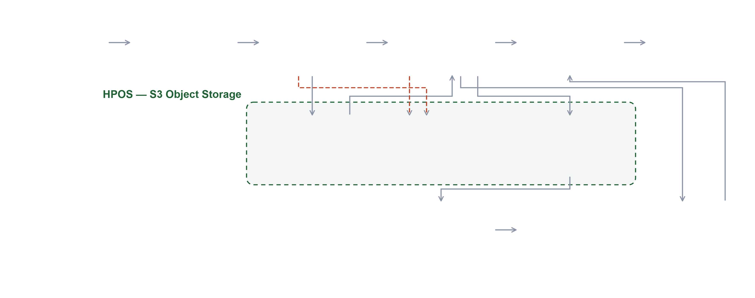
Current Architecture & Advantages
Main flow
Exception path
Core component
HPOS S3 storage
Source Systems
Kafka Topic
Event Processor
Aggregator
Monetization
ACO / RPM Billing
Gateway · ASDE · future apps
Partitioned · durable buffer
Validate & de-duplicate
Billing rules · classify
Price · map · deliver
Receives billing file
RAW_EVENTS
Exception Events
Parquet Files
Source of truth
Billable · non-billable
Rejected · failed
Query on S3
Dashboards
MongoDB
SQL over Parquet
Tableau-style BI
Daily & monthly aggregates
Audit & Reconciliation
Control totals · full event lifecycle · applies across every stage above
Decoupled by design
Trustworthy billing
Built for scale
Analytics for free
Each stage scales and fails independently; new sources added without touching billing.
No data loss and no duplicate charges — every event validated and traceable.
Billions of events per month; horizontal scale with bounded memory.
Dashboards generated by simply querying the S3 Parquet storage.
Notes:
The full pipeline. Event Processor and Aggregator write into HPOS S3 object storage. Monetization delivers the billing file to the ACO/RPM billing system. Parquet in S3 is queried directly to power dashboards. The advantages below are the design guarantees stated in business terms.

Slide 2
Reusability, Extensibility & Reporting
One engine, many use cases. Any application that needs to bill a third party or aggregator plugs into the same pipeline — and inherits its controls and reporting.
Inherited Capabilities
Configured, Not Coded
Extension Points
Event ingestion & buffering
New source system
Billing provider adapters
Validation & de-duplication
New aggregator or recipient
Additional validation rules
Aggregation & classification
New billing cluster
New aggregation dimensions
Pricing rule engine
Pricing & rate changes
Alternate pricing models
Billing file generation
Billing schedule & format
Chargeback / showback
Source-to-Metering
Metering-to-Billing
Reporting & Governance
Events published vs received
Processed usage vs billing export
Usage by source, app and provider
Missing & duplicate detection
Provider acknowledgement tracking
Revenue by aggregator and API
Source-level control totals
Replay-backed corrections
Audit-ready event lifecycle
Every new use case starts at 80% complete.
Faster time to market · lower cost per use case · consistent controls · lower risk
Notes:
Built once, reused everywhere. A new billing use case inherits the pipeline: capabilities it does not rebuild, onboarding done by configuration, and clear extension points. The same platform delivers reconciliation and reporting for every use case.

Slide 3

Future Scope & Enterprise Value
A staged path from today's billing pipeline to an enterprise monetization platform.
Horizon 1 · Near term
Horizon 2 · Mid term
Horizon 3 · Long term
Onboard additional enterprise source systems
New billing providers via adapters
Single enterprise monetization platform
Quick invoice adjustments — credits, re-rates and corrections on demand
Usage-based and tiered pricing models
Centralised usage governance & policy
Chargeback / showback for internal consumers
Forecasting and revenue insight
Exception dashboards for operations
Partner-facing usage transparency
Automated reconciliation reporting
Self-service analytics on the Parquet layer
Quick Invoice Adjustments
STRATEGIC VALUE
Because every billed line traces back to its source events, corrections can be applied and re-issued quickly — credits, re-rates and disputed items resolved without a manual reconstruction exercise.
Build once. Bill anything. Govern centrally.
Notes:
Three horizons. Near term we broaden sources and add quick invoice adjustments. Mid term we add providers, pricing models and self-service analytics. Long term the Metering Engine becomes the enterprise monetization and usage-governance foundation.

